Slide 1


Social Buzz:
Data Insights

Slide 2


Today's agenda
Project recap
Problem
The Analytics team
Process
Insights
Summary

Slide 3

Social Buzz is experiencing rapid growth and needs to
quickly adjust to its global scale.
Accenture has embarked on a journey with them to
help them with their Big Data Strategies, recommend steps for a successful IPO and identify their top five content categories.
Project Recap

Slide 4

Social Buzz has over 100,000 pieces of data per day across varieties of content.
Clocking 500 million active users on a daily basis.
They require a strategy to handle such large volumes of data and capitalize upon that.
Problem

Slide 5



Myself
Data Analyst
The Analytics team
Marcus Rompton
Senior Principle
Andrew Fleming
Chief Technical Architect

Slide 6
Process
1
Understanding the Data and Business Problem
2
Data Cleaning
3
Data Modelling
4
Data Analysis
5
Extracting Insights

Slide 7
Insights
There has been a gradual increase in sentiment score indicating increase in usage of the platform over time.
There has been a drop in engagement during the month July and the cause for the same needs to be identified.
60% of reactions are positive, 30% are neutral and 10% are negative. There is scope for improvement.

Slide 8
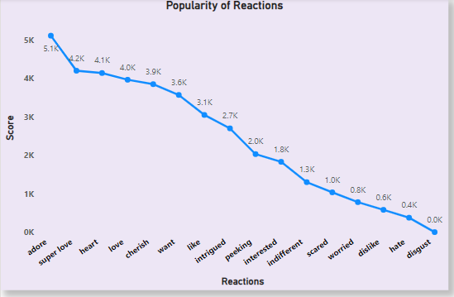
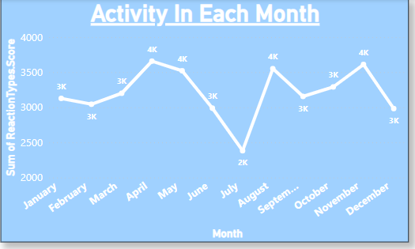
Visualizing Vital Data Points

Slide 9
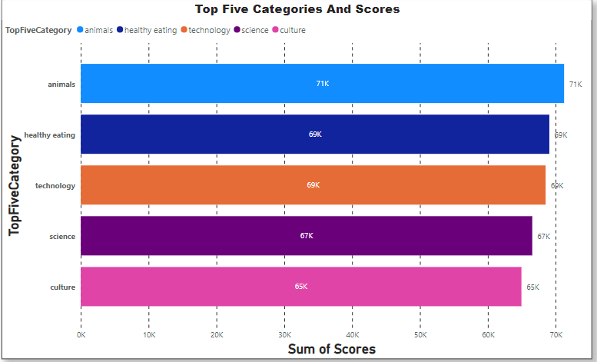
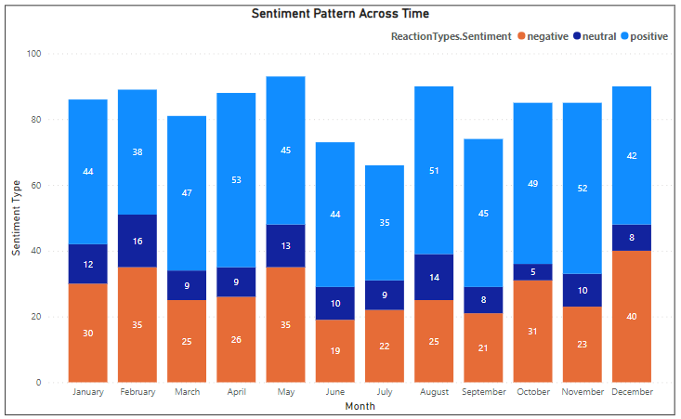

Slide 10


The top five categories are Animals, Healthy Eating, Technology, Science and Culture
There needs to be improvement in type of content in other categories
Summary
The negative sentiment rate is significant.
The content receiving negative sentiments needs to be identified and changed
Company needs to focus more on feedback data and make continuous improvements
Strategies can be improved before going for an IPO.

Slide 11
Thank you!
ANY QUESTIONS?

